Slide 1
UNIT ONE – Part Two

Slide 2
Features of Management
Management is Goal-Oriented
Management integrates Human, Physical and Financial Resources
Management is Continuous
Management is all Pervasive
Management is a Group Activity

Slide 3
Importance of management
It helps in Achieving Group Goals
Optimum Utilization of Resources
Reduces Costs
Establishes Sound Organization
Establishes Equilibrium
Essentials for Prosperity of Society

Slide 4
FAYOL’s PRINCIPLE OF MANAGEMENT
1. Division of work
2. Authority and responsibility
3. Discipline
4. Unity of command
5. Unity of direction
6. Subordination of individual interest to the common good
7. Remuneration of personnel
8. Centralization
9. Scalar chain
10. Order
11. Equity
12. Stability
13. Initiative
14. Esprit de corps

Slide 5

Division of work

Slide 6
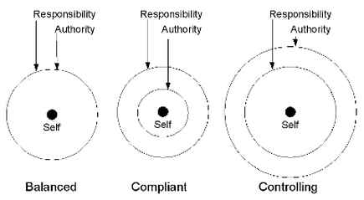
Authority & Responsibility

Slide 7

Discipline

Slide 8

Unity of Command & Direction

Slide 9
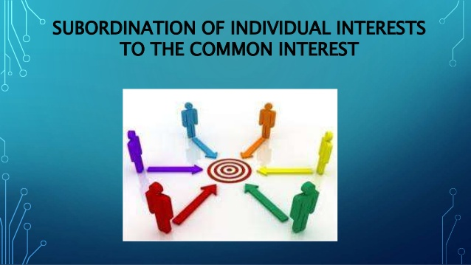

Slide 10


Remuneration

Slide 11


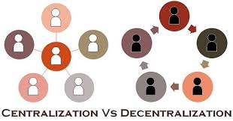
Centralization & Scalar chain

Slide 12
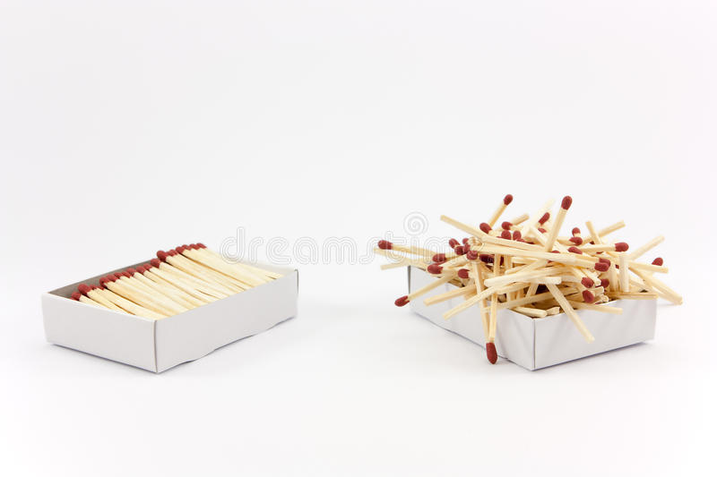

Order

Slide 13


Equity & Stability

Slide 14




Initiative & Team spirit

Slide 15
Types of Managers- Role of managers
Manager
Someone who works with and through other people by coordinating their work activities in order to accomplish organizational goals

Slide 16
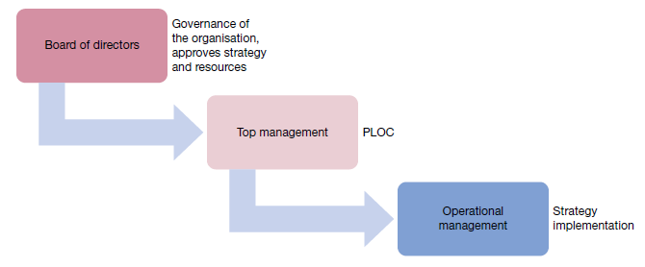

Slide 17
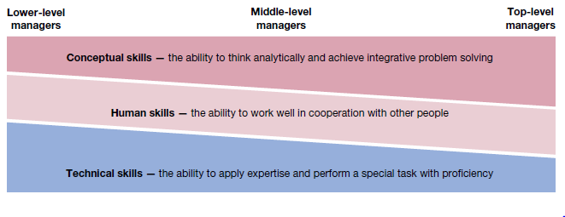
Skills and Managerial levels

Slide 18
Types of managers
Line managers
Staff managers
Functional managers
General managers
Administrators

Slide 19
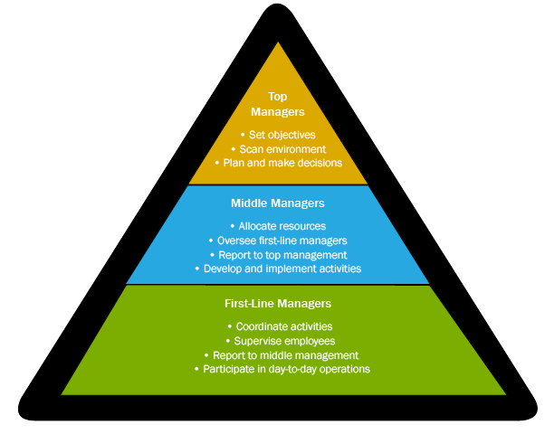

Slide 20
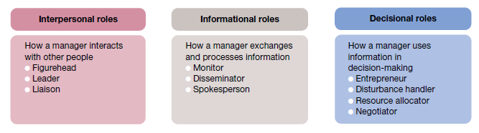
Mintzberg’s Management Roles Approach

